Slide 1
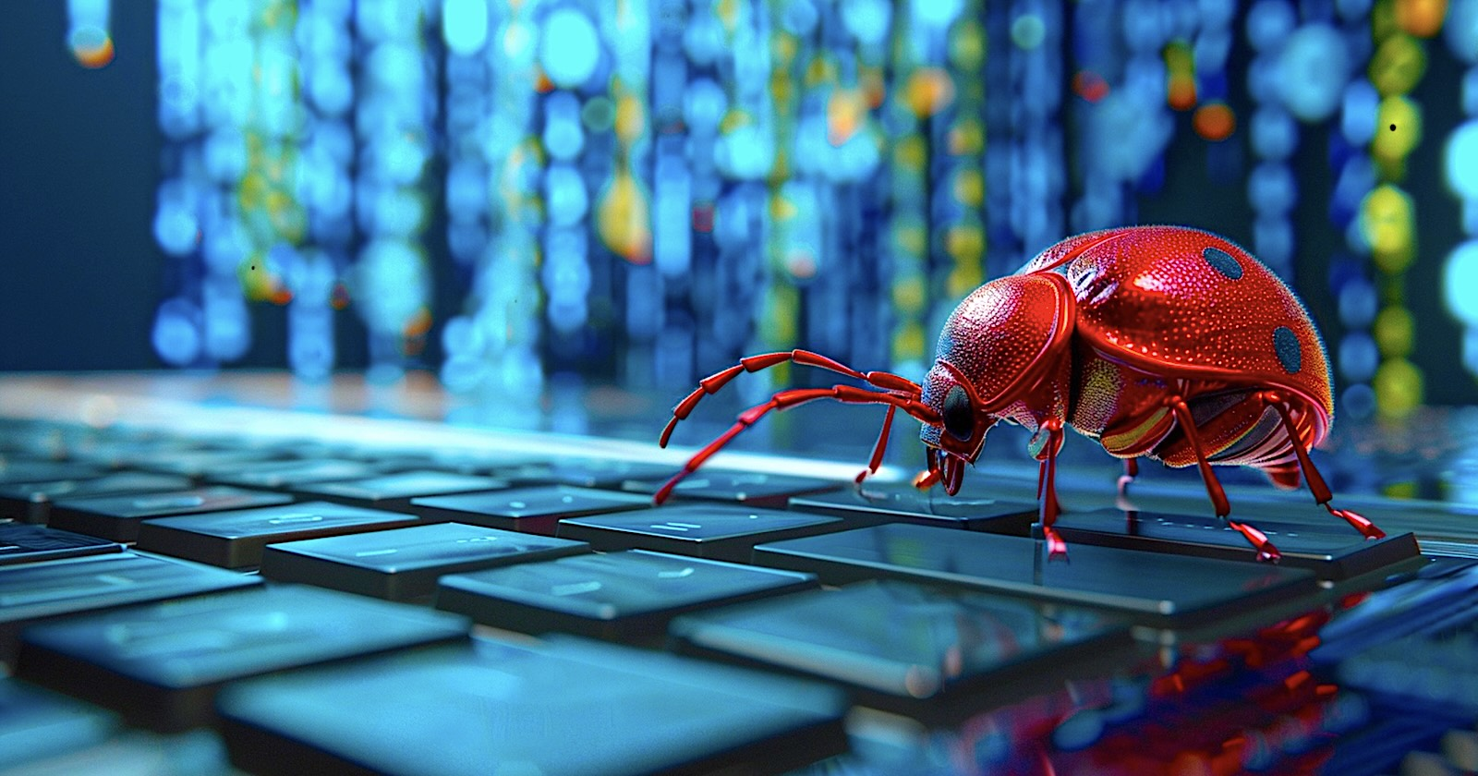


COMPUTER BUGS AND MALWARE
PRESENTED BY S/LT KELMET JATO

Slide 2
MAIN IDEA
Computer bugs and malware are two of the most significant challenges in modern computing, each affecting systems in different but often interconnected ways. These defects can cause programs to behave unpredictably, produce incorrect results, crash, or expose security vulnerabilities. Although bugs and malware differ in origin and intent, they are closely related because many cyberattacks exploit existing bugs to gain unauthorized access or execute harmful actions. As software grows more complex and cyber threats become more advanced, understanding the relationship between bugs and malware is essential for improving system reliability, strengthening security, and protecting users and organizations from potential harm.

Slide 3
PLAN
I. INTRODUCTION
II. HISTORICAL EVOLUTION
III. UNDERSTANDING COMPUTER BUGS AND MALWARE
IV. RELATIONSHIP BETWEEN BUGS AND MALWARE
V. DETECTION AND PREVENTION
VI. CASE STUDIE
VII. MODERN TRENDS
CONCLUSION

Slide 4

I. Introduction
Definition of Bugs
A bug is an error, flaw, or mistake in a computer program that causes it to behave unexpectedly or incorrectly.
A computer bug is an unintentional anomaly within software, arising from mistakes in coding, misinterpreted requirements, design flaws, or integration issues. Bugs can cause programs to produce wrong results, malfunction, expose vulnerabilities, or fail under certain conditions.

Slide 5

DEFINITION OF MALWARE
Computer malware (short for malicious software) is any program or code specifically created to damage, disrupt, steal data, or gain unauthorized access to computer systems. Unlike normal software, malware is intentionally designed with harmful objectives, such as spying on users, encrypting files for ransom, taking control of devices, or destroying data. Malware spreads in various ways through infected email attachments, malicious websites, USB drives, software vulnerabilities, or social engineering tricks.
Common types include viruses, worms, trojans, ransomware, spyware, adware, rootkits, and botnets. Because of its destructive nature, malware is one of the biggest threats to cybersecurity today.
Notes:
Importance of the Topic

Slide 6
Importance of the Topic
The topic of computer bugs and malware is crucial because both pose serious threats to cybersecurity, privacy, financial stability, and the overall integrity of digital systems. Computer bugs, although unintended, can create vulnerabilities that allow attackers to infiltrate networks, steal data, or disrupt critical services. Malware, which is intentionally crafted for harm, exploits these weaknesses to spread, compromise sensitive information, encrypt files for ransom, or take control of systems. The consequences are far-reaching: organizations face significant financial losses from downtime, data breaches, and recovery costs; individuals risk having their private data stolen or misused; and essential infrastructures such as healthcare, banking, transportation, and government services can be severely impacted. As technology becomes more integrated into daily life and business operations, understanding and addressing bugs and malware becomes essential to maintaining trust, security, and the reliable functioning of modern digital systems.

Slide 7
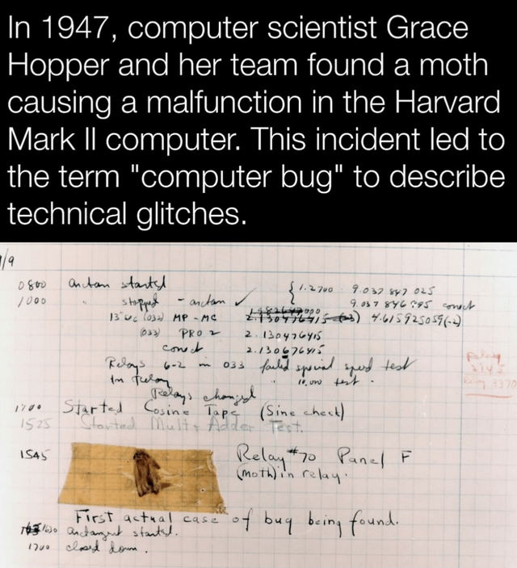
The history of computer bugs began with a literal moth causing a malfunction in the HARVARD MARK II computer in 1947, an event popularized by Grace hopper. Over time, the term "bug" evolved to describe any defect in software or hardware, leading to a wide range of bugs throughout history, from simple syntax errors to complex security vulnerabilities and software glitches that caused major financial losses or system failures.
II. HISTORICAL EVOLUTION
1. HISTORY OF BUGS

Slide 8
II. HISTORICAL EVOLUTION
Early history
1947: Grace Hopper and her team found a real moth causing a malfunction in the Harvard Mark II computer. They removed the moth and taped it to their logbook, labeling it "first actual case of bug being found". This event popularized the term "bug" and the related term "debug" in the context of computing.
1870s: The term "bug" was used by THOMAS EDISON to describe flaws in electrical circuits
Software and hardware bugs
1980s: The first computer viruses, like the LEHIGH and CASCADE viruses, appeared.
1993: A bug in the Intel Pentium processor caused incorrect floating-point calculations, leading to a costly recall and customer backlash, says beta Quality Assurance, notes Smart Bear, and Quality Assurance.

Slide 9
II. HISTORICAL EVOLUTION
1996: The Ariane 5 flight V88 was destroyed 40 seconds after takeoff due to a software bug.
1997: The ”deep blue” supercomputer used a software bug to trigger its winning move against chess champion Garry Kasparov,
1999: The Y2K bug, a software flaw that could have caused widespread system failures at the turn of the millennium, led to billions of dollars being spent to update computer systems.
2014: The Heartbleed bug, a vulnerability in the Open SSL cryptographic library, put servers across the internet at risk, exposing sensitive user information like passwords and encryption keys, Notes Kaspersky.
2020: A bug in City Bank's payment software led to the accidental transfer of approximately $900 million instead of just the interest payment.
2020: The Knight Capital trading incident resulted in a loss of $460 million in 45 minutes due to a program mistaking a test environment for a production environment, mentions Smart Bear.
Notes:
notes a YouTube video.

Slide 10
2. History of Malware
II. HISTORICAL EVOLUTION
Early Concepts (1960s–1970s)
The idea of self-replicating programs began as a theoretical concept in the 1960s when mathematician John von Neumann discussed “self-reproducing automata.”
In 1971, the first known computer worm, CREEPER, was created as an experiment on ARPANET. It was not malicious; it simply displayed the message “I’m the creeper, catch me if you can!”
Shortly after, another program called REAPER was created to delete CREEPER essentially the first antivirus program.
The Rise of Real Malware (1980s)
As personal computers became more popular, malware moved from theory to reality.
Notes:
ARPANET

Slide 11
II. HISTORICAL EVOLUTION
The Era of Cybercrime (2000s)
Malware became professional and financially motivated.
Famous attacks included:
“ILOVEYOU” (2000) – crashed systems worldwide through email.
“Code Red & SQL Slammer” (2001–2003) – targeted servers and caused internet slowdowns.
“MyDoom” (2004) – one of the fastest-spreading email worms ever.
Cybercriminal organizations began using malware for spam, identity theft, botnets, and financial fraud.
Rootkits, trojans, and spyware became widespread.
Notes:
ARPANET

Slide 12
II. HISTORICAL EVOLUTION
The 1986 Brain Virus, created in Pakistan, was the first major PC virus. It spread via floppy disks and infected the boot sector.
In 1988, the Morris Worm caused massive disruption across the early internet, exploiting network vulnerabilities and leading to the first major cybersecurity crisis.
This decade also saw the birth of antivirus companies like McAfee and Symantec.
Internet Expansion & Mass Infection (1990s)
With the spread of the World Wide Web, malware grew rapidly in complexity.
Macro viruses (like Melissa in 1999) used Microsoft Office documents to spread.
Email became a major infection vector.
Malware was mostly created by hobbyists, pranksters, or researchers—not yet organized criminals.
Notes:
ARPANET

Slide 13
II. HISTORICAL EVOLUTION
Advanced Persistent Threats (APTs) & Cyber Warfare (2010s)
Malware evolved into a tool for espionage and geopolitics.
“Stuxnet” (2010)—a highly sophisticated worm targeting Iranian nuclear facilities marked the beginning of large-scale cyber weapons.
Ransomware emerged as a major threat:
CryptoLocker (2013)
WannaCry (2017) – infected hundreds of thousands worldwide
NotPetya (2017) – one of the most destructive cyberattacks ever
Smartphone malware also increased with the growth of Android and iOS devices.
Notes:
ARPANET

Slide 14
II. HISTORICAL EVOLUTION
6. Modern Malware (2020s–Present)
Cybercrime has become a massive global industry.
Ransomware groups now operate like companies, offering Ransomware-as-a-Service (RaaS).
New malware trends include:
AI-assisted attacks
Fileless malware (runs in memory, harder to detect)
Supply-chain attacks (e.g., SolarWinds)
Malware targeting IoT devices, smart homes, industrial systems
Malware is now part of state conflicts, organized crime, and corporate espionage.
Notes:
ARPANET

Slide 15
III. Understanding COMPUTER Bugs AND MALWARE
COMPUTER BUGS
Bugs are usually not deliberate, they happen because of mistakes made during the design, coding, or testing stages of software development. Even small bugs can lead to major problems, such as system crashes, security vulnerabilities, or data corruption.
Bugs arise for several reasons, including human error, incomplete requirements, miscommunication between developers, or the complexity of modern systems. As software grows larger and more interconnected, the chances of bugs increase. There are many types of bugs, such as syntax errors (mistakes in the code structure), logic errors (incorrect instructions or decisions in the program), and runtime bugs (problems that appear only when the software is running under certain conditions).
Developers use techniques like debugging, testing, code reviews, and automated tools to identify and fix bugs. While it is nearly impossible to create software that is 100% bug-free, good development practices can greatly reduce their impact. Understanding bugs is essential not only for programmers but also for users, as bugs can affect system performance, user experience, and even security.

Slide 16
Types of Bugs
Syntax Errors
Syntax errors occur when the code violates the grammatical rules of a programming language. These are often simple mistakes such as missing brackets, incorrect punctuation, or misspelled keywords that prevent the program from compiling or running. Syntax errors are usually the easiest to detect because the compiler or interpreter immediately flags them.
2. Logic Errors
Logic errors happen when the program runs, but produces incorrect results due to flawed reasoning or wrong instructions. The code is syntactically correct, but it does not do what the programmer intended. These bugs are harder to find because they do not stop the program; they simply cause it to behave incorrectly.

Slide 17
Types of Bugs
3. Runtime Errors
Runtime errors appear while the program is running, often due to unexpected conditions such as dividing by zero, accessing invalid memory, or missing files. These bugs cause the program to crash, hang, or behave unpredictably. Unlike syntax errors, runtime errors are detected only during execution.
4. Concurrency / Threading Issues
Concurrency bugs occur in software that uses multiple threads or processes running simultaneously. These issues include race conditions, deadlocks, and thread synchronization errors. They can cause inconsistent results, performance problems, or complete system freeze. Concurrency bugs are notoriously difficult to reproduce and debug because they depend on timing and system behavior.

Slide 18
Types of Bugs
5. Memory Leaks and Buffer Overflows
Memory leaks happen when a program allocates memory but fails to release it after use. Over time, this leads to increased memory consumption and slowdowns, eventually causing the system to crash. Buffer overflows occur when a program writes more data into a memory buffer than it can hold. This can overwrite other data, corrupt memory, or expose serious security vulnerabilities making buffer overflows one of the most dangerous classes of bugs.
Causes of Bugs
Impact and famous incidents

Slide 19
Causes of Bugs
1) Poor Coding Practices
Bugs often occur when developers use inconsistent or careless coding techniques. This includes writing unstructured code, failing to follow programming standards, skipping comments, or not testing code thoroughly. Poor practices make the software harder to maintain, easier to break, and more prone to hidden errors that surface later.
2) Miscommunication in Requirements
Many bugs originate before any code is written. If project requirements are unclear, incomplete, or misunderstood between stakeholders (developers, clients, analysts), the resulting software may not function as intended. This leads to features being implemented incorrectly, missing functionality, or behaviors that conflict with user expectations.

Slide 20
Causes of Bugs
3. Hardware Incompatibility
Software may behave incorrectly or fail entirely when run on hardware it was not designed or tested for. Differences in processors, memory, drivers, or peripheral devices can trigger bugs. Hardware-specific limitations—such as limited memory or different instruction sets—can also cause unexpected crashes or poor performance.
4. Edge Cases Not Considered
Edge cases are unusual or extreme input conditions that developers may overlook during design or testing. When the software encounters these rare situations, it may crash, behave unpredictably, or produce incorrect results. Examples include very large numbers, empty inputs, unexpected user actions, or simultaneous events that the system was not prepared to handle.

Slide 21
Impact OF BUGS IN OUR SOCIETY
1. FINANCIAL IMPACT
Bugs can cause multi-million-dollar losses by disrupting transactions, corrupting financial data, or shutting down services.
Software errors in trading systems may trigger stock market disruptions, incorrect trades, or erroneous calculations.
Example of impact:
Unexpected downtime costing companies thousands to millions per hour.
Incorrect billing or payments affecting millions of customers.

Slide 22
Impact OF BUGS IN OUR SOCIETY
2. SAFETY AND HUMAN-LIFE IMPACT
Some bugs occur in systems that control transportation, healthcare, or industrial processes. These can lead to:
-Loss of life
-Injuries
-Vehicle or equipment failures
-Compromised medical treatments

Slide 23
Impact OF BUGS IN OUR SOCIETY
3. SECURITY IMPACT
Even if bugs are accidental, attackers can exploit them. Common examples:
Buffer overflows → allow hackers to run malicious code
Logic errors → allow privilege escalation
Race conditions → break access controls
Bugs are often the root cause of:
Malware infections
Data breaches
System compromises

Slide 24
Impact OF BUGS IN OUR SOCIETY
4. OPERATIONAL AND PRODUCTIVITY IMPACT
System crashes, slowdowns, or unexpected behavior reduce employee productivity.
Maintenance teams must spend time debugging instead of building new features.
Bugs delay product launches and reduce user trust.
5. REPUTATIONAL IMPACT
Major incidents damage:
Public trust
Brand image
Investor confidence
For tech companies, reputation can influence stock price and customer retention.

Slide 25
Famous Bug Incidents in Computing History
1. THE THERAC-25 RADIATION MACHINE BUG (1985–1987)
A race condition in the software caused patients to receive 100times the intended radiation dose which Resulted in severe injuries and several deaths.
Highlighted the dangers of relying solely on software without hardware safeguards.
2. THE ARIANE 5 FLIGHT 501 EXPLOSION (1996)
A numeric overflow during software conversion caused the rocket to self-destruct 40 seconds after launch.
Estimated loss: $370 millions.
The reused Ariane 4 software was not retested for Ariane 5 conditions.

Slide 26
Famous Bug Incidents in Computing History
3. THE Y2K BUG (1999–2000)
Caused by storing years with 2 digits (e.g., “99”), leading to potential date rollovers to “1900”.
Massive global remediation project cost $300–600 billion.
Fortunately prevented major failures, but remains the most expensive bug mitigation effort ever.
4. THE MARS CLIMATE ORBITER LOSS (1999)
NASA lost the spacecraft because one team used imperial units while another used metric units.
The navigation system was thrown off course, resulting in the probe burning up in Mars’ atmosphere.
Cost: $125 millions.

Slide 27
Famous Bug Incidents in Computing History
5. THE KNIGHT CAPITAL TRADING BUG (2012)
A deployment error activated old test code that executed millions of unintended trades in 45 minutes.
Loss: $460 millions. This Nearly bankrupted the company.
6. HEARTBLEED BUG (2014)
A critical bug in OpenSSL, used by millions of websites. Leaked sensitive data such as passwords, keys, and encrypted communications.
Considered one of the worst security bugs of the decade.
7. BOEING 737 MAX MCAS SOFTWARE FAULT (2018–2019)
Faulty logic in the flight-control system (MCAS) caused two plane crashes. Resulted in 346 deaths. This Led to grounding of the entire 737 MAX fleet for almost 2 years.

Slide 28
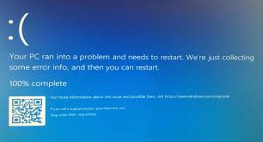
Famous Bug Incidents in Computing History
8. WINDOWS 10 UPDATE DELETING FILES (2018)
A bug in Microsoft’s update logic caused personal files to be deleted automatically. Affected many users worldwide.
It raised concerns about quality assurance in major software release

Slide 29
MALWARE
UNDERSTANDING MALWARE
Malware (malicious software) is any software intentionally designed to damage, disrupt, steal, or gain unauthorized access to computer systems. Here are the major types:
1. Viruses
A virus is malicious code that attaches itself to legitimate files and spreads when those files are executed.
How viruses work
Infect executable files, documents, or system areas, Activate when the user runs the host file and Can corrupt data, damage systems, or spread to other machines
Key characteristics
Needs human action to spread (opening a file, running software)
Often causes data corruption or system slowdowns

Slide 30
MALWARE
2. WORMS
A worm is a self-replicating malware that spreads automatically, without human involvement.
How worms work: Exploit network vulnerabilities, Spread across computers rapidly and Consume bandwidth and system resources
Key characteristics
Autonomous replication
Can cause massive network slow Downs
Examples: ILOVEYOU, WannaCry worm

Slide 31
MALWARE
3. TROJANS (TROJAN HORSES)
A trojan is malware disguised as a legitimate program, tricking users into installing it.
How trojans work: Pretend to be useful tools, games, installers but Once installed, open backdoors or steal data.
Often used to deliver other malware (like ransomware)
Key characteristics:
Relies on social engineering
Does NOT self-replicate
Used for spying, stealing passwords, remote control

Slide 32
MALWARE
4. Ransomware
Ransomware encrypts files or locks the system and demands payment to restore access.
How ransomware works: Delivered via email attachments, malicious links, or exploit kits
Encrypts data with strong cryptography
Displays a ransom note demanding money (usually cryptocurrency)
TYPES
Crypto-ransomware: encrypts files
Locker-ransomware: locks the entire device
Leakware: Threatens to leak stolen data

Slide 33
MALWARE
5. SPYWARE
Spyware secretly monitors user activity and steals sensitive information.
How spyware works:
Tracks keystrokes (keyloggers)
Captures screenshots
Steals browser data or login credentials
Monitors communications
Common targets
Banking information
Email/passwords
Personal data for identity theft

Slide 34
MALWARE
6. ROOTKITS
A rootkit is a stealthy type of malware designed to give attackers hidden, persistent, and privileged access to a system.
How rootkits work: - Modify system files and OS components
Hide processes, files, and malware activity
Allow attackers remote control without being detected
Key characteristics
Very difficult to detect
Can remain in the system for long periods
Often used to maintain access after an initial attack.

Slide 35
MALWARE
7. BOTNETS
A botnet is a network of infected devices (bots or zombies) controlled remotely by a cybercriminal (botmaster).
How botnets work: Malware infects devices and connects them to a command-and-control server, Attackers control thousands or millions of compromised devices,
Botnets are used for
Distributed Denial of Service (DDoS) attacks
Spamming campaigns
Cryptocurrency mining
Credential stuffing
Malware distribution
Key characteristics
Devices act without the owner’s knowledge
Highly scalable and dangerous
Can take down major websites or infrastructures

Slide 36
Summary table for malwares
Malware Type | Self-Replicating | Needs User Action | Primary Goal | Notable Feature
Virus | ❌ Needs host file | ✔️ Yes | Damage/spread | Attached to legitimate files
Worm | ✔️ Yes | ❌ No | Rapid spread | Exploits networks automatically
Trojan | ❌ No | ✔️ Yes | Backdoor, theft | Disguised as legitimate software
Ransomware | ❌ No | Sometimes | Extortion | Encrypts files or locks device
Spyware | ❌ No | Sometimes | Surveillance | Keylogging, data theft
Rootkit | ❌ No | Sometimes | Hidden control | Hard to detect, deep system access
Botnet | ✔️ Via bot malware | ❌ No | Mass attacks | Large-scale remote control

Slide 37
Propagation Methods
1. Email Attachments
Malware is often delivered through malicious files attached to emails. Cybercriminals send emails that appear legitimate sometimes mimicking banks, employers, or service providers to trick users into opening infected attachments such as PDFs, Word documents, compressed files (.zip), or executables. Once opened, the file may install malware, run hidden scripts, or exploit vulnerabilities in document readers.
2. Drive-By Downloads
A drive-by download occurs when a user visits a compromised or malicious website that automatically installs malware without requiring any interaction. Attackers exploit vulnerabilities in browsers, plugins, or outdated software. Even legitimate websites can be infected if their servers are compromised, making this method dangerous for ordinary users.

Slide 38
Propagation Methods
3. USB Devices (Removable Media)
Malware can spread through infected USB flash drives, external hard drives, or memory cards. When connected to a computer, the device may automatically execute malicious code (especially on systems with autorun enabled) or trick the user into opening infected files. This method is common in environments where computers are not connected to the internet, including some corporate or government networks.
4. Social Engineering
Social engineering relies on manipulating human behavior rather than exploiting technical flaws. Attackers use deception such as fake alerts, phishing messages, fake software updates, or impersonation—to convince victims to download malware or reveal sensitive data. Because it targets human psychology, social engineering remains one of the most effective malware delivery techniques.
5. Exploiting Software Vulnerabilities
Many malware infections occur because attackers find and exploit weaknesses in software, operating systems, or network services. These vulnerabilities allow malware to execute code remotely, escalate privileges, or spread across systems without user interaction. Examples include unpatched operating systems, insecure applications, or outdated network services. Worms such as WannaCry spread globally by exploiting vulnerabilities automatically.

Slide 39

Motivations for Malware
1. Financial Gain
Most modern malware is created for profit. Cybercriminals use ransomware, banking trojans, crypto-jackers, and credential stealers to generate money by:
Demanding ransom payments
Stealing credit card or banking information
Mining cryptocurrency using victims’ computers
Selling stolen data on dark markets Financially motivated attacks are often organized, with groups operating like professional businesses.
2. Espionage
Malware is frequently used for spying on individuals, companies, or governments. Cyber espionage aims to steal confidential information such as:
Intellectual property
Trade secrets
Diplomatic communications
Notes:
SECURE SOCKET LAYER

Slide 40
Motivations for Malware
Military or strategic data These attacks are usually stealthy, long-term, and often associated with advanced persistent threats (APTs) backed by nation-states.
3. Hacktivism
Hacktivists use malware as a tool to promote political or social causes. Their goals may include:
Disrupting services to protest (e.g., DDoS attacks)
Exposing confidential information (data leaks)
Defacing websites Hacktivist groups are motivated by ideology rather than profit and often target institutions they view as unethical.
4. Cyberwarfare
Nation-states use malware as a digital weapon in geopolitical conflicts. Cyberwarfare aims to:
Disrupt critical infrastructure (power grids, communication systems)
Sabotage enemy operations.

Slide 41
Motivations for Malware
Spread misinformation
Prepare for or complement traditional military actions Examples include highly sophisticated malware like Stuxnet, designed to cause physical damage to industrial systems
5. Personal Challenge or Bragging Rights
Some malware authors are motivated by curiosity, technical challenge, or the desire to gain notoriety. Especially common in early malware history or among inexperienced hackers (“script kiddies”), these attacks may not have a financial or political goal. Instead, the designers want to:
Test their skills
Gain reputation in underground communities
Experiment with new technique

Slide 42
IV. RELATIONSHIP BETWEEN BUGS AND MALWARE
1. How Bugs Create Vulnerabilities for Malware
Software bugs mistakes in coding, logic, or design often create security weaknesses that attackers can exploit. These vulnerabilities can:
Allow unauthorized access
Enable execution of malicious code
Leak sensitive data
Crash or destabilize systems
Common examples include memory mismanagement, improper input validation, race conditions, and misconfigurations. Malware authors scan software and operating systems for these flaws because they provide an entry point. Essentially, bugs are the doors, and malware is what enters through them when left open.

Slide 43
IV. RELATIONSHIP BETWEEN BUGS AND MALWARE
2. Exploit Development Using Buffer Overflows & Zero-Days
Attackers often turn bugs into exploits special scripts or programs that take advantage of the flaw.
Buffer Overflows
A buffer overflow occurs when a program writes more data into memory than it can hold. Attackers exploit this bug to:
Inject malicious code
Overwrite memory
Gain control of the system This technique is foundational in many classic worms and trojans.
Zero-Days
A zero-day vulnerability is a bug unknown to the vendor or security community. Malware that exploits such bugs is extremely dangerous because:
No patch exists yet
Detection is difficult
Attacks can spread fast and silently Advanced Persistent Threat (APT) groups and cybercriminals often pay high prices for zero-day exploits to gain covert access to targets.

Slide 44
iv. RELATIONSHIP BETWEEN BUGS AND MALWARE
3. Patch Management and Software Updates
The most effective defense against bugs is regular patching. Vendors release security updates to fix discovered vulnerabilities, closing the door before attackers can use it.
Good patch management:
Reduces exposure to known vulnerabilities
Prevents malware from exploiting old bugs
Minimizes risk from worms and automated attacks
Ensures compliance with security standards
Failing to update systems leaves organizations vulnerable; many major attacks succeeded because systems were unpatched despite available fixes.

Slide 45
V. Detection and Prevention
A. Bugs
1. Testing
Unit Testing: Verifies individual functions or modules in isolation.
Integration Testing: Ensures combined components work together as expected.
Regression Testing: Confirms that new changes haven’t broken existing functionality.
2. Static and Dynamic Code Analysis
Static Analysis: Examines source code without executing it to detect syntax issues, vulnerabilities, code smells, and security flaws.
Dynamic Analysis: Evaluates the program while it runs to identify runtime errors, memory leaks, and unexpected behavior.
3. Debugging Tools
Tools like debuggers, profilers, and logging frameworks help developers locate and fix logic errors, crashes, and performance issues.
4. Secure Coding Practices
Use validated input handling, parameter sanitization, safe memory management, and industry best practices to minimize vulnerabilities.

Slide 46
Detection and Prevention
B. Malware
1. Antivirus and Endpoint Detection & Response (EDR)
Detect, quarantine, and remove malicious files.
EDR provides behavioral monitoring, threat hunting, and real-time detection.
2. Firewalls and IDS/IPS
Firewalls: Filter incoming and outgoing network traffic.
IDS: Detect suspicious activity.
IPS: Actively block or mitigate threats.
3. Sandboxing
Executes files or applications in isolated environments to observe behavior safely and detect malware before it reaches the main system.
4. Regular Updates and Patches: Keeps software, systems, and security tools up to date, closing vulnerabilities that malware could exploit.
5. User Awareness and Phishing Training
Educates users on safe practices, social engineering risks, password hygiene, and recognizing phishing attempts.
Notes:
IDS (Intrusion Detection System)
IPS (Intrusion Prevention System)

Slide 47
VI. Case Studies
Heartbleed Bug (2014)
A critical vulnerability in OpenSSL, used by millions of websites for encrypted communications (HTTPS).
The flaw was in the “Heartbeat” extension, allowing attackers to read sensitive server memory.
Exposed private keys, passwords, session cookies, and confidential data.
Made global news because it affected major services like Google, Yahoo, and many banking systems.
Millions of servers had to be urgently patched and security certificates had to be reissued.
NB
A small coding bug in widely used open-source software can have global consequences.

Slide 48
Case Studies
WannaCry Ransomware (2017)
WannaCry was a global ransomware attack that infected more than 300,000 computers across 150+ countries within hours.
It used a Windows vulnerability called “EternalBlue”, originally developed by the NSA and later leaked.
Once inside a system, it encrypted files and demanded Bitcoin payment to unlock them.
Major victims included hospitals, telecommunications companies, banks, and government agencies.
The attack spread rapidly because many systems were not patched, even though Microsoft had released a fix months earlier.
NB
Unpatched systems create massive global vulnerabilities.

Slide 49
Case Studies
Equifax Breach (2017)
One of the largest data breaches in history, exposing the personal information of 147 million people.
Caused by a failure to patch a known vulnerability in a public-facing web application.
The vulnerability allowed attackers to perform remote code execution (RCE).
Exposed sensitive data such as Social Security numbers, addresses, birthdates, and credit records.
The breach resulted in lawsuits, fines, and long-term reputational damage.
NB
A single unpatched bug can compromise an entire organization.
Notes:
(Apache Struts CVE-2017-5638)

Slide 50
Case Studies
SolarWinds Supply-Chain Attack (2020)
A highly sophisticated attack in which hackers compromised ‘SolarWinds’ software build process.
Attackers injected malicious code into the “SolarWinds Orion” platform update, which was then distributed to customers.
Affected U.S. government agencies, Fortune 500 companies, defense contractors, and critical infrastructure providers.
The malicious update created a backdoor that allowed attackers to spy on systems.
It demonstrated how compromising one trusted vendor can impact thousands of organizations.
NB
Supply-chain security is now one of the biggest cybersecurity challenges.
Notes:
(Apache Struts CVE-2017-5638)

Slide 51
VII. Modern Trends
1. AI-Driven Malware
Malware that uses artificial intelligence to become more adaptive, stealthy, and effective.
AI can help malware automatically evade detection by learning how security tools work.
It can generate new variants of malicious code in real time to bypass antivirus signatures.
AI-powered phishing can craft personalized, convincing messages based on user behavior.
Future threats may include malware that autonomously explores networks and chooses the best attack path.
NB: AI makes cyberattacks faster, smarter, and harder to detect.
2. Zero-Day Markets
Underground (and sometimes legal) marketplaces where hackers buy and sell undisclosed software vulnerabilities.
A “zero-day” is a vulnerability that the software vendor doesn’t know about and hasn’t patched.
These markets supply vulnerabilities to cybercriminals, intelligence agencies, and nation-states.
Prices can reach hundreds of thousands of dollars depending on the software and exploit reliability.
Zero-days are often used in high-profile attacks before defenders can respond.
NB: Zero-days give attackers a major advantage and reduce time for detection.
Notes:
(Apache Struts CVE-2017-5638)

Slide 52
Modern Trends
3. Supply Chain Attacks
Attacks that target the weaker or more trusted parts of an organization’s supply chain instead of attacking the organization directly.
Inserting malicious code into software updates (as in the SolarWinds attack).
Compromising third-party plugins, libraries, or cloud vendors.
Hardware manipulation during manufacturing.
NB: Why it matters: A single compromised vendor can infect thousands of customers.
4. Cloud-Based Threats
Cyberattacks that target cloud environments, services, and storage.
Misconfigured cloud storage (public buckets exposing data).
Credential theft for cloud admin accounts.
Attacks on APIs used by cloud applications.
Data exfiltration from multi-tenant environments.
Ransomware and crypto-jacking in cloud infrastructure.
NB: As organizations migrate to the cloud, attackers follow—exploiting misconfigurations, weak identity controls, and the shared responsibility model.
Notes:
(Apache Struts CVE-2017-5638)

Slide 53
Modern Trends
5. Advanced Persistent Threats (APT Groups)
Highly skilled, well-funded threat actors often linked to nation-states.
Use stealthy techniques to stay inside networks for months or years.
Focus on espionage, sabotage, or intelligence gathering.
Examples: APT28, APT29, Lazarus Group, Equation Group.
NB: Cyber warfare and geopolitical conflict increasingly involve APT operations.
6. Automated Bug Detection Using AI/ML
Using machine learning and AI models to detect software vulnerabilities.
Automatically scans large codebases for logic errors, insecure patterns, or memory issues.
Helps find bugs earlier in the development cycle.
Reduces reliance on manual testing.
Tools like GitHub Copilot Security, CodeQL, and DeepCode use this approach.
NB: AI is transforming software quality assurance and vulnerability discovery.
Notes:
(Apache Struts CVE-2017-5638)

Slide 54
Conclusion
Modern digital systems face a wide range of risks from software bugs that create vulnerabilities to increasingly sophisticated forms of malware, including AI-driven threats and supply-chain attacks. These risks highlight the critical need for secure development practices such as thorough testing, code analysis, patch management, and adherence to security standards. As technology evolves, cybersecurity plays an essential role in protecting individuals, organizations, and nations from disruption, financial loss, and data compromise. In today’s interconnected world, cybersecurity is no longer optional; it is a foundational pillar of modern society, ensuring trust, safety, and resilience across all digital environments.
Notes:
(Apache Struts CVE-2017-5638)

Slide 55
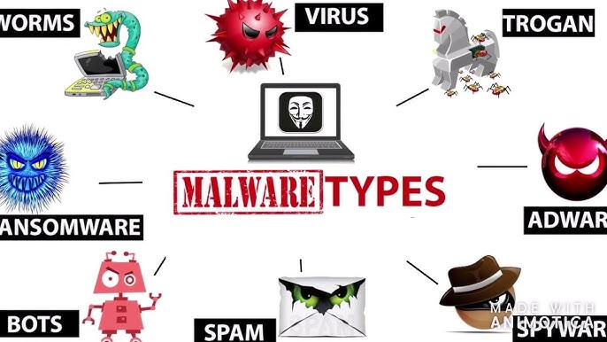


THE END
QUESTIONS

