Slide 1



Personal Cybersecurity
Protecting Your Digital Life

Slide 2







OBJECTIVE
To give you all the tools you need to review, secure, and protect your personal digital life.

Slide 3



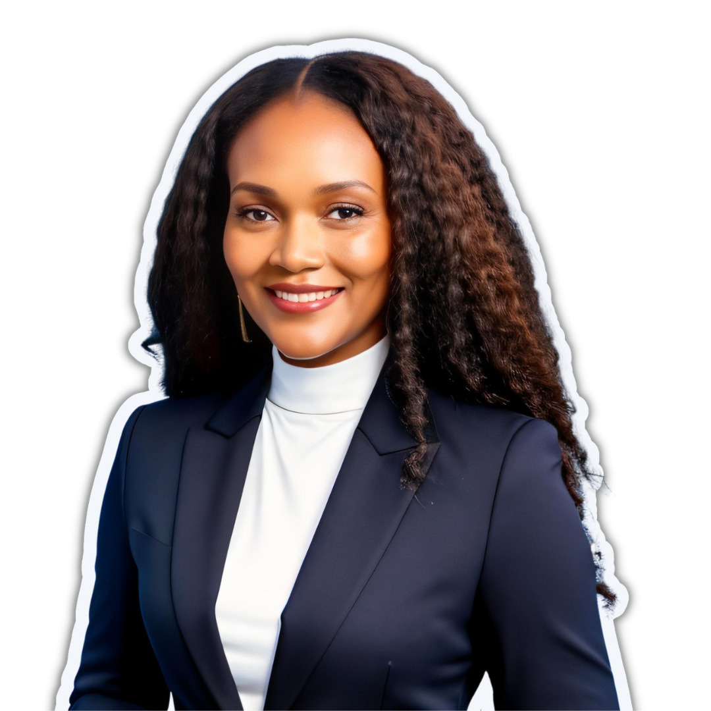


ABOUT ME
Ex-HACKER AT IBM X-FORCE RED
FOUDER AT CYBERCILE​
HACHED VICTIM TURNED HACKER​
ONLINE PRIVACY ENTHUSIAST

Slide 4



AGENDA
01
ONLINE SECURITY VS ONLINE PRIVACY
06
MINIMISING YOUR ONLINE FOOTPRINTS​
02
07
REMOVING PERSONAL INFORMATION ONLINE​
STATISTICS
03
IDENTIFYING YOUR ONLINE ACCOUNTS
08
BUILDING YOUR PERSONAL THREAT MODEL
04
LOCKING DOWN YOUR ACCOUNTS​
09
Q&A
05
RUNNING A SECURITY CHECK ON YOUR ONLINE ACCOUNTS
10
CONCLUSION

Slide 5



ONLINE SECURITY VS ONLINE PRIVACY​
Online privacy and online security are two important concepts that relate to different aspects of protecting oneself online.
ONLINE SECURITY FOCUSES ON PROTECTING DIGITAL DEVICES AND ACCOUNTS FROM UNAUTHORIZED ACCESS, THEFT, OR DAMAGE BY CYBERCRIMINALS.​
ONLINE PRIVACY REFERS TO THE CONTROL AN INDIVIDUAL HAS OVER THEIR PERSONAL DATA AND HOW IT IS COLLECTED, USED, AND SHARED BY OTHERS ONLINE. ​

Slide 6







STATISTICS
87%
OF PERSONAL DEVICES HAVE NO CYBERSECURITY OR PRIVACY CONTROLS
75%
OF DEVICES ARE LEAKING DATA
40%
OF IP ADDRESSES ARE AVAILABLE ON THE DARK WEB
39%
OF DEVICES HAVE MALWARE OR HOME IS EXPOSED
23%
HAVE OPEN PORTS AND HOME NETWORKS

Slide 7







IDENTIFYING ALL YOUR ACCOUNTS
Apps on your phone
Apps in your email
Emails
Social Media​
Chrome browser saved passwords​
Subscriptions​
Search name check website ​
Credit cards etc
YOU CAN NOT PROTECT WHAT YOU DON’T HAVE. THE BEST PRACTICE IS TO IDENTIFY ALL YOUR ONLINE ACCOUNTS AND THE AVERAGE PERSON CAN EASILY HAVE MORE THAN 100 ACCOUNTS​

Slide 8



WHAT TO DO WITH THE ACCOUNTS YOU ​IDENTIFIED​
REMOVE ANY DUPLICATES OF THE PASSWORD IN YOUR PASSWORD MANAGER, TO MAKE IT CLEAR WHICH ONE TO USE.​
IF THE SITE OFFERS THIRD-PARTY ACCESS TO THE ACCOUNT,CHECK THE LIST OF SITES THAT HAVE AUTHORIZED ACCESS. REVOKE ANY ACCESS THAT ISN’T NEEDED.​
IN GENERAL, TAKE NOTE OF THE DATA THAT IS STORED IN THE ACCOUNT. IF THE ACCOUNT WERE TO BE HACKED, HOW BAD WOULD IT BE?​

Slide 9
WHAT TO DO WITH THE ACCOUNTS YOU ​IDENTIFIED​
APPLY BEST PRACTICES IN SECURING ​PASSWORDS
REMOVE ANY UN-NECESSARY DATA IN YOUR ACCOUNT
IF YOU NO LONGER USE THE ACCOUNT, HAVE THE ACCOUNT DEACTIVATED OR DELETED.​
REVIEW THE CONNECTED DEVICES TO YOUR ACCOUNT AND REMOVE ANY DEVICES THAT YOU NO LONGER USE.​
LOG OUT, AND MAKE SURE THAT YOU CAN LOG BACK IN SUCCESSFULLY WITH THE NEW CREDENTIALS.
REMOVE ANY DUPLICATES OF THE PASSWORD IN YOUR PASSWORD MANAGER, TO MAKE IT CLEAR WHICH ONE TO USE.

Slide 10


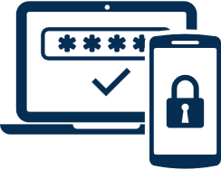
LOCKING YOUR ACCOUNTS DOWN​
PASSWORDS
PASSWORD MANAGER​
2FA
Use a unique, random password consisting of 15+ character for each account.​
Include uppercase, lowercase, numbers, and characters.​
Use password phrases instead of dictionary words​
Avoid anything that relates back to you​
Change all the passwords at least once per year.​
Lie on your password reset questions
I highly recommend migrating all your password to one, and systematically going through the to change every password to a unique random one.​
Every new account you create can also have a unique random password tracked by the system.​
if you already have password manager, change the master password.​
Change the password on every account in your password manager.
IMPLEMENT 2-FACTOR AUTHENTICATION (2FA) FOR ALL SITES THAT OFFER it. ​

Slide 11



RUN A SECURITY CHALLENGE
UPON COMPLETING THE PREVIOUS TASKS, IT'S ADVISABLE TO PERFORM A SECURITY CHALLENGE, WHICH IS MADE EASIER IF YOU ALREADY USE A PASSWORD MANAGER. THIS CHALLENGE INVOLVES TESTING AND STRENGTHENING YOUR DIGITAL SECURITY TO IDENTIFY AND ADDRESS VULNERABILITIES IN YOUR ONLINE ACCOUNTS AND PERSONAL INFORMATION PROTECTION.

Slide 12



SECURITY CHALLENGE​
CHECK IF ANY OF YOUR ACCOUNTS RE-USE THE SAME PASSWORD.
​
CHECK IF ANY HAVE BEEN INVOLVED IN A KNOWN COMPROMISE (I.E., THE SERVER OF THE COMPANY GOT HACKED). ​
ONE OF THE WAY YOU CAN CHECK IS THROUGH GOOGLE. TYPE ALLINTEXT: (YOUR EMAIL) OR GO TO HAVEIBEENPWNED.COM​
CHECK IF ANY OF THE PASSWORDS ARE OLD.​
CHECK IF ANY OF THE PASSWORDS ARE INSECURE (TOO SHORT, ETC.).

Slide 13


SEARCH YOURSELF​
A PERSONAL CYBERSECURITY CHECK ISN’T COMPLETE WITHOUT​ SEARCHING YOURSELF TO SEE WHAT PUBLIC​ INFORMATION IS AVAILABLE ABOUT YOU​.
​
THERE ARE TWO BROAD CATEGORIES OF INFORMATION AVAILABLE TO PEOPLE SEARCHING FOR YOU:
INFORMATION YOU PUT OUT ABOUT YOURSELF (THROUGH SOCIAL MEDIA, YOUR WEBSITE, ETC.); AND
INFORMATION PUT OUT ABOUT YOU BY THIRD PARTIES (NEWS ARTICLES, DATA BROKERS,ETC.).​​
IT’S A GOOD PRACTICE TO DO A “BACKGROUND CHECK” ON YOURSELF TO SEE WHAT YOU FIND. A COUPLE PLACES TO TRY:​
1. GOOGLE​
2. BING​
3. SPOKEO

Slide 14
HOW TO SEARCH YOURSELF
​To begin, search for your name on various search engines such as Google, DuckDuckGo, Bing, and Yandex. To refine your search and retrieve more specific information, use the following search terms:​
“First & Last Name “Zip code”​
“First & Last Name “number and street address”
“First & Last Name”” some part of your phone number”​
“Last Name” ”number and street address”​
“Last Name” ”Some part of your phone number”​
“First & Last Name” “profession”​
“First & Last Name”” Business Name”​
​If you find no relevant results, try repeating the search with no quotation marks. Remember to repeat the process periodically, as the information available may change.

Slide 15
HOW TO SEARCH YOURSELF
Google Dork examples:
allintext: (username) - searches for specific text on any web page​
allintitle: "full name" - searches for pages that contain titles with specific text​
filetype: (email) filetype: pdf - searches for pdf files that contain specific text​
intitle: (your name) (your email) - searches for titles that begin with "your name" but "your email" can be anywhere else in the page.​
inanchor: "your name" - searches for an exact anchor text used on any links ​
intext: (your name) - searches for pages that contain certain characters or strings inside their text

Slide 16


YOUR DATA THROUGH ​
THE EYES OF AN HACKER
01
02
INFORMATION THAT WILL HELP THEM CRACK YOUR PASSWORD​
INFORMATION THAT THEY CAN USE TO IMPERSONATE YOU​
04
03
INFORMATION THAT REVEALS THE TYPE OF SYSTEM/
SOFTWARE YOU USE ​
INFORMATION THEY CAN USE TO GET MORE INFORMATION OUT OF YOU​

Slide 17
REMOVING PERSONAL INFO FROM THE WEB​
MANY COMPANIES WILL HAVE A DESIGNATED WEBPAGE OR FORM FOR MAKING DATA REMOVAL REQUESTS. TO INITIATE THE PROCESS, SIMPLY NAVIGATE TO THE PRIVACY POLICY PAGE OF THE RELEVANT WEBSITE AND LOOK FOR INSTRUCTIONS ON HOW TO SUBMIT A REQUEST FOR THE REMOVAL OF YOUR INFORMATION. THE WEBSITE WILL GUIDE YOU THROUGH THE PROCESS AND PROVIDE YOU WITH ALL THE DETAILS.​

Slide 18
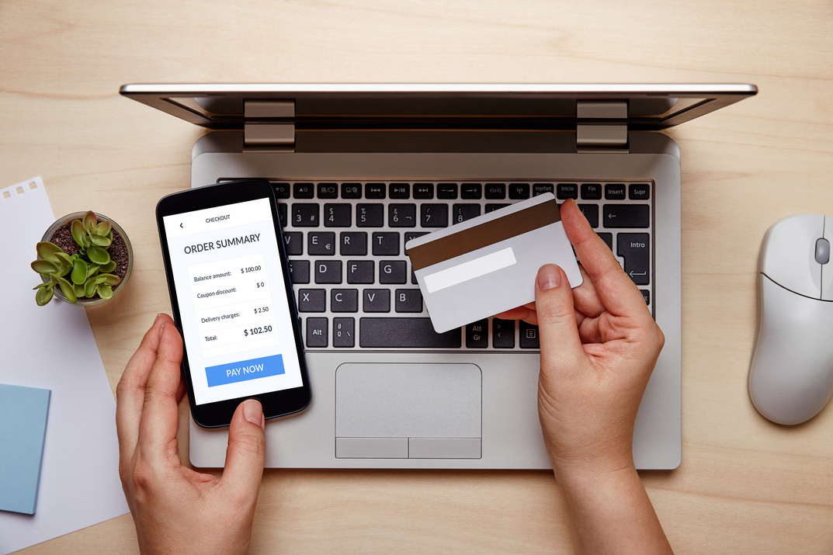



PERSONAL THREAT MODEL
WHAT ARE YOU PROTECTING
WHO ARE YOU PROTECTING IT FROM​
WHAT MEASURES CAN​
YOU PUT IN PLACE​
Email
Online accounts
location
business​ assets
etc.
Hackers
Advertiser
government
stalkers
etc.
Secure password
TWO-FACTOR AUTHENTICATION (2FA)
VPN
AD​ blockerS
etc.

Slide 19



Q & A
FOR MORE CYBERSECURITY TIPS, FOLLOW
@CYBERCILELLC

Slide 20







THINGS TO KEEP IN MIND
Everyone's starting point for digital security is different, so it's important to begin where you are.​
Commitment to an annual digital security review can be a helpful practice in staying on top of your digital security.​
Some steps outlined in this presentation may take time, but any effort will be beneficial in improving your digital security.​

Slide 21
THINGS TO KEEP IN MIND
Security decisions often involve a trade-off between convenience and security. It's important to make these choices consciously and understand that everyone's preferences may be different.​
The practices outlined in this presentation are what I am comfortable with and may not be perfect, but they are effective in improving digital security.

Slide 22
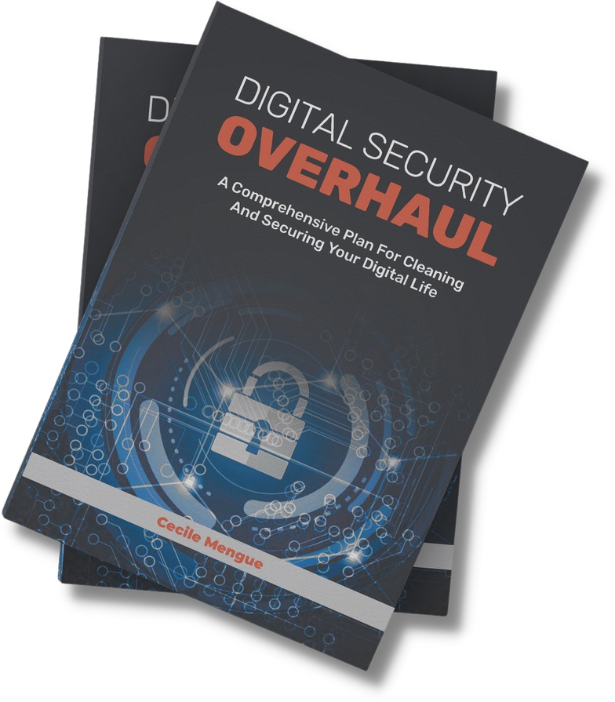


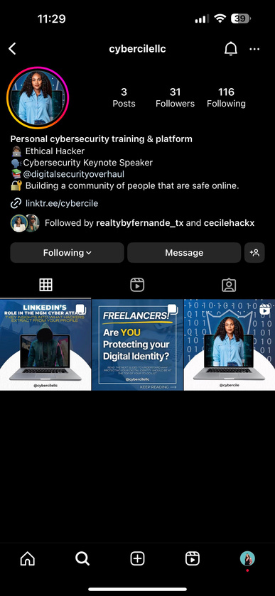
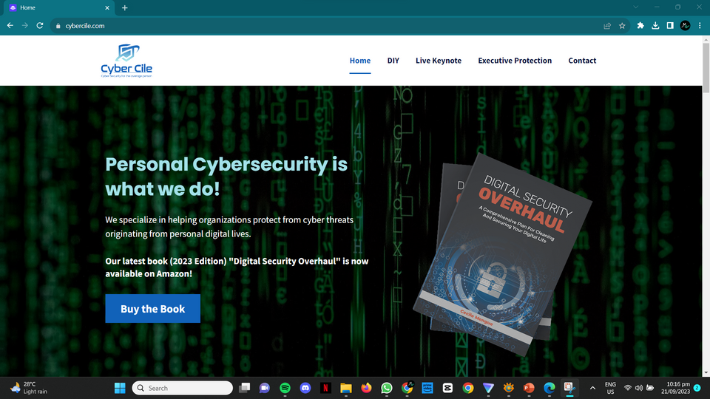
THANK YOU!
BUY MY BOOK ON AMAZON
AND STAY DIGITALLY SAFE!!
LEARN MORE AT WWW.CYBERCILE.COM
BE UPDATED!
FOLLOW ME @CYBERCILEON INSTAGRAM!

